Slide 1
Machine Learning and how does it work?

Slide 2
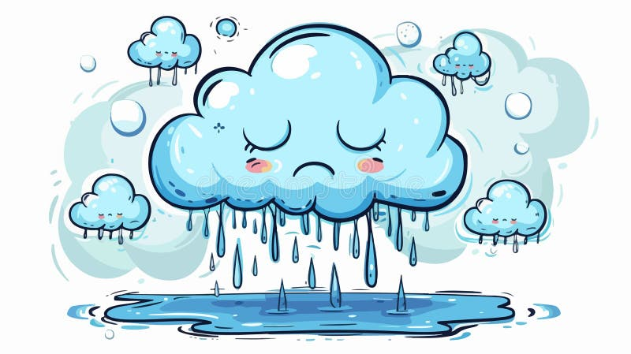
What is machine Learning
A technology that uses data to learn from and make future prediction
Temperature | Wind Speed | Day | Hour | Label
3.4 | 2.3 | Saturday | 3 pm | Rain
4.0 | 0.1 | Friday | 10 am | Sunny
3.0 | 0.3 | Saturday | 3 pm | Rain
0.1 | 1.2 | Saturday | 2 pm | Rain
4.0 | 3.0 | Tuesday | 5 am | Sunny
4.0 | 3 | Sun | 11 am
Temperature | Wind Speed | Day | Hour
3.4 | 2.3 | Saturday | 3 pm
4.0 | 0.1 | Friday | 10 am
3.0 | 0.3 | Saturday | 3 pm
Label
Rain
Sunny
Rain
80%
80%
Training
20%
0.1 | 1.2 | Saturday | 2 pm
4.0 | 3.0 | Tuesday | 5 am
20%
Rain
Sunny
Testing

Slide 3
How does ML Works?
Machine Learning (ML) is a branch of artificial intelligence that enables computers to learn patterns from data and make predictions or decisions without being explicitly programmed.
Teaching a Child Fruits (Apple & Orange)
Imagine teaching a child to recognize apples and oranges:
Training (Learning from Data) – You show the child many apples and oranges, telling them which is which.
Pattern Recognition – The child notices patterns like color, shape, and texture (features).
Prediction (New Data) – When given a new fruit, the child compares it with learned patterns to classify it as an apple or orange.
Similarly, in ML, a model learns patterns from labeled data and uses them to classify new inputs.

Slide 4
examples
1. Doctor Diagnosing a Patient (Disease Prediction)
A doctor examines past patient records (training data) and symptoms (features) to predict a new patient’s disease (classification). Similarly, ML models learn from medical data to predict diseases based on symptoms.
2. Car Sales Prediction
A salesperson analyzes past sales trends (historical data) like car type, price, and demand to estimate future sales. Similarly, ML models use past sales data to forecast future trends.
3. YouTube/Netflix Recommendations
Just like a librarian suggests books based on your past reads, ML models analyze your watch history to recommend videos/movies you might like.

